Slide 1
Validation Using JavaScript
- Aditya Chandeliya

Slide 2
What is Client Side Validation? And Why do we need this?

Slide 3
<Let’s Validate>

Slide 4
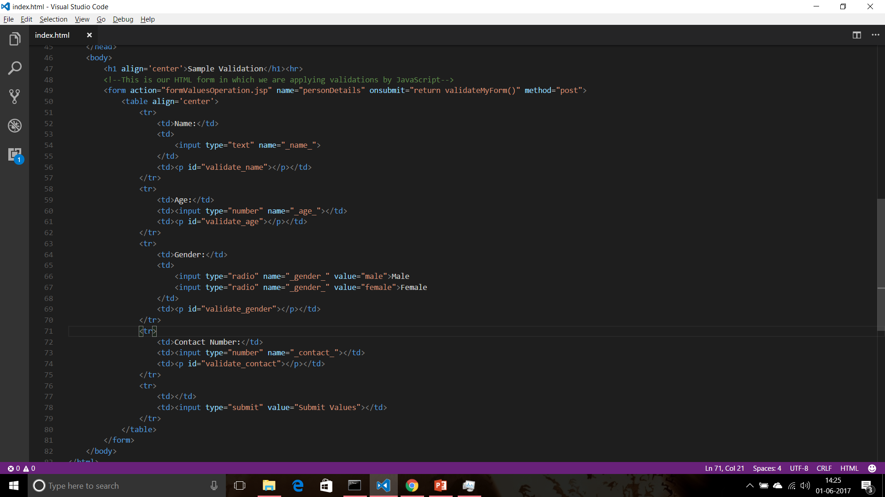

Slide 5
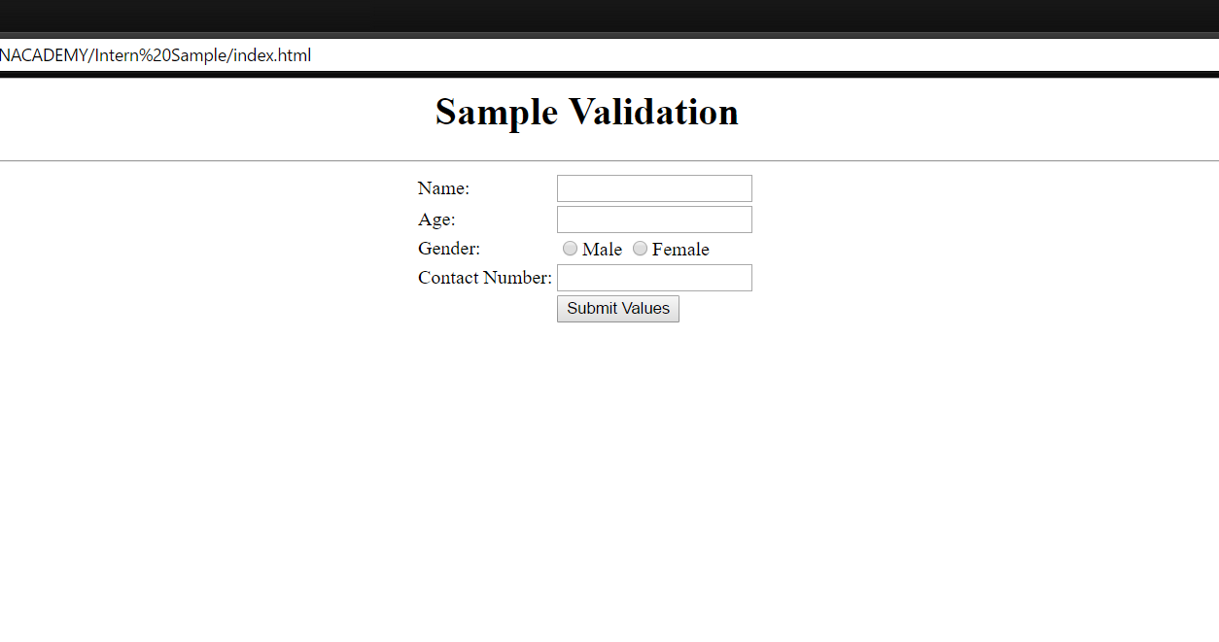
This is how our output look like:

Slide 6
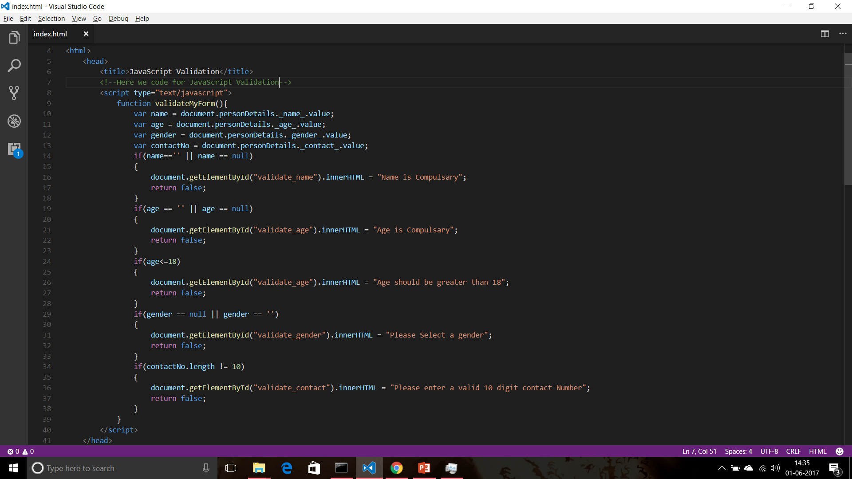

Slide 7
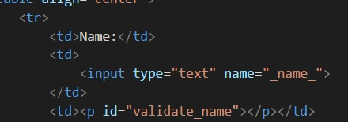

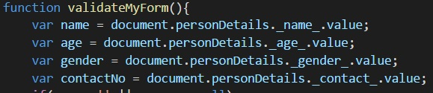
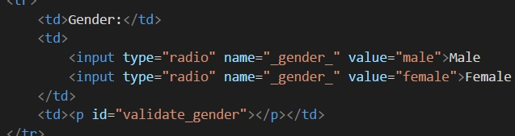
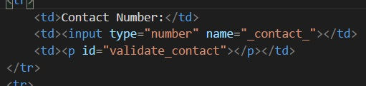
Fetching user Inputs in JavaScript code

Slide 8
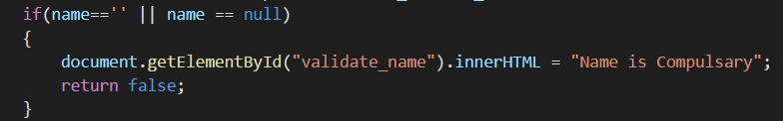
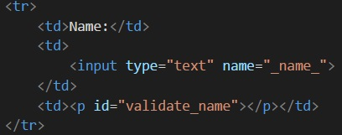
Validating Name
Fetching input value in var name
JavaScript Code to
Validate Name
HTML Code for Name

Slide 9
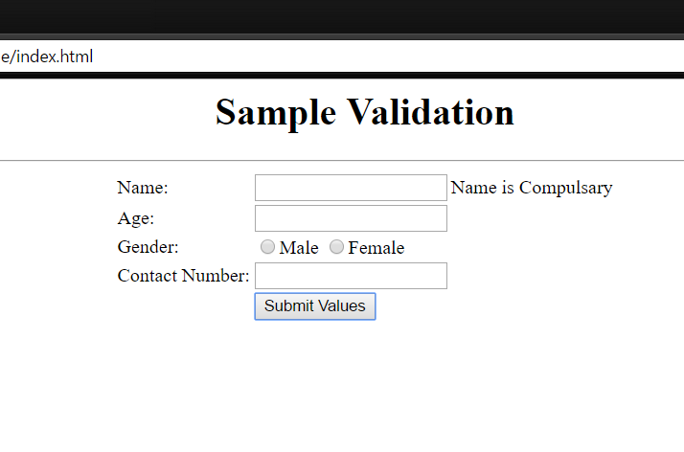
Validating Name
Attempt of Submitting form without entering name!!

Slide 10
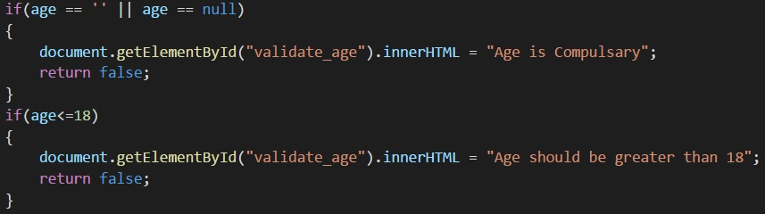
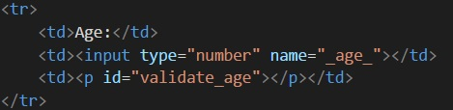
Validating Age
Fetching input value in var age
JavaScript Codes to
Validate Age
HTML Code for Age

Slide 11
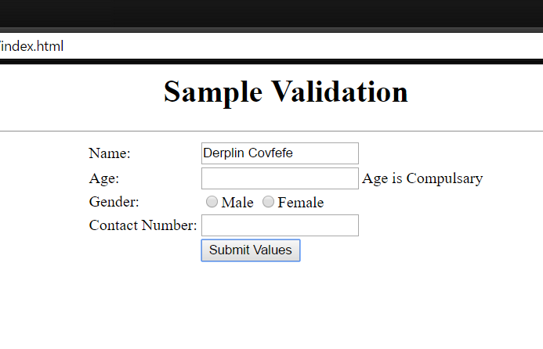
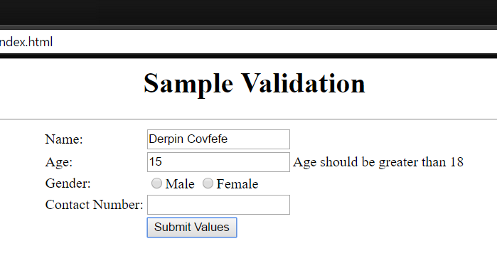
Validating Age
Attempt of Submitting form without entering age!!
Attempt of Submitting form entering age less then 19!!

Slide 12
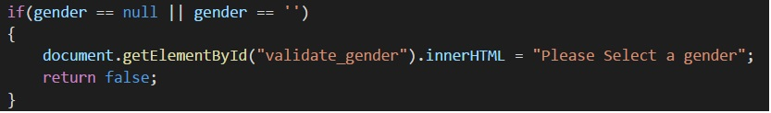
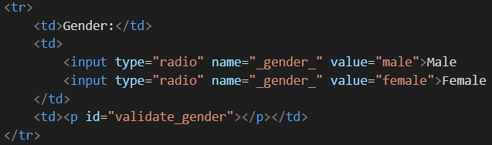
Validating Gender
Fetching input value in var gender
JavaScript Codes to
Validate Gender
HTML Code for Gender

Slide 13
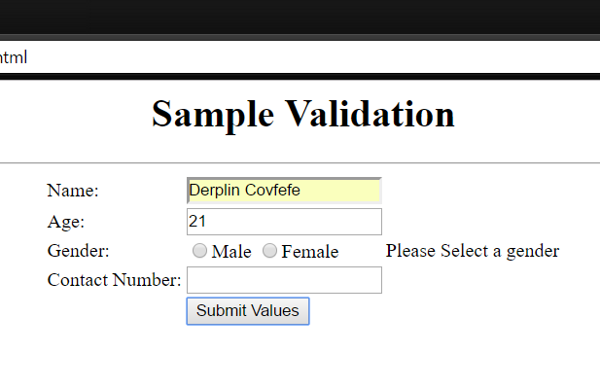
Validating Gender
Attempt of Submitting form without Selecting Gender!!

Slide 14
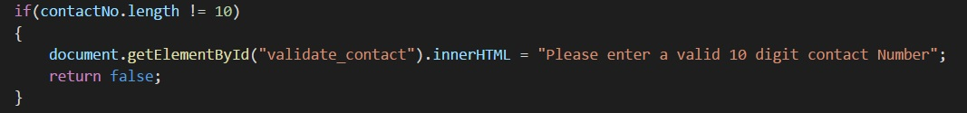
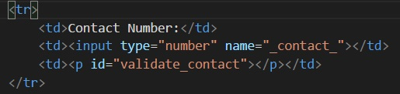
Validating Contact
Fetching input value in var contactNo
JavaScript Codes to Validate Gender
HTML Code for Gender

Slide 15
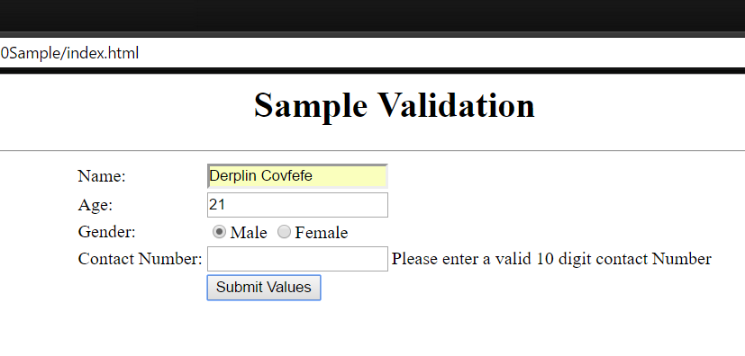
Validating Contact
Attempt of Submitting form without entering valid 10 digit contact number!!

Slide 16
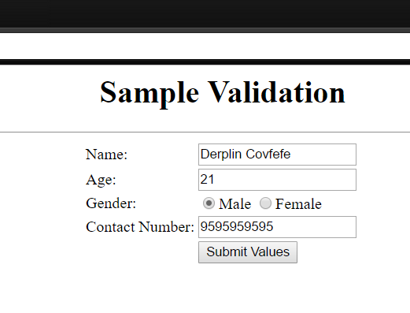
Correct Format

Slide 17
Thank You ☺
-Aditya Chandeliya
Get this JavaScript Sample document at:
https://github.com/imchandeliya/JavaScript-Samples/blob/master/Unacademy%20Sample.html

